Slide 1

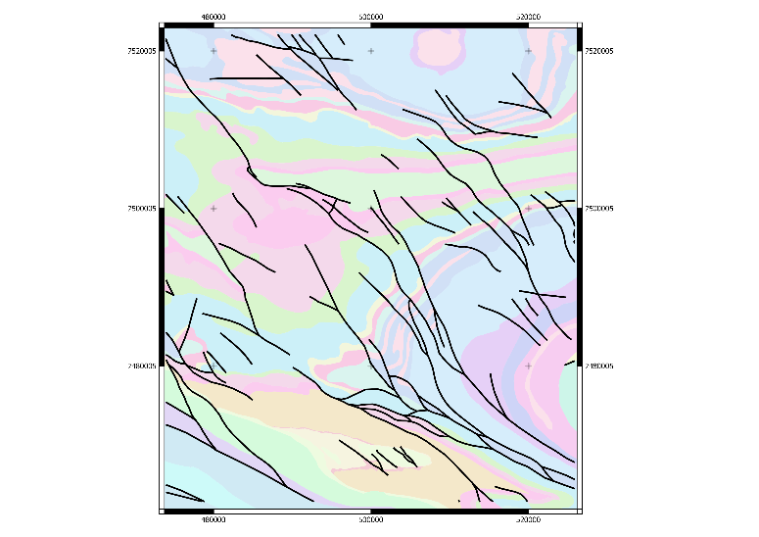
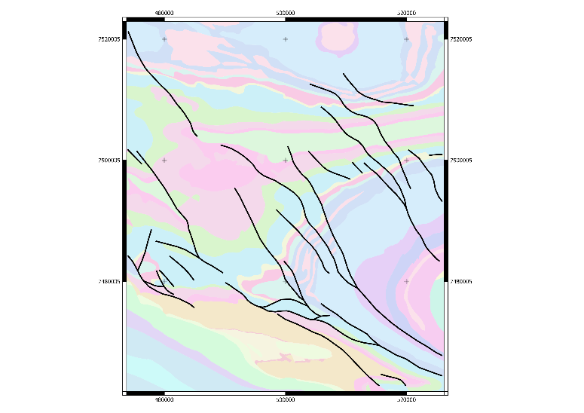
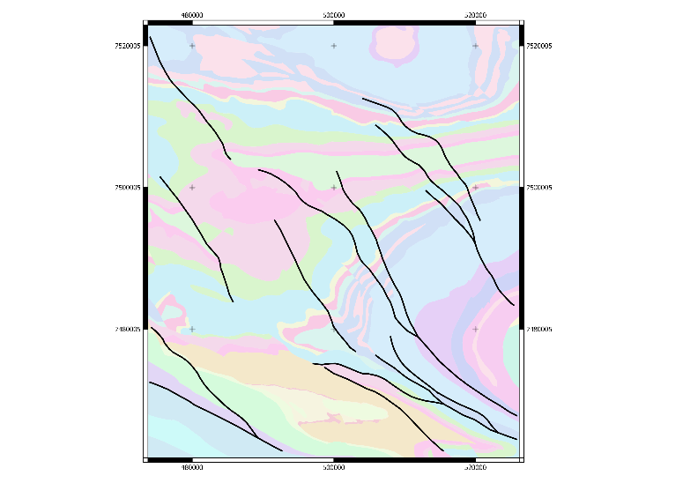
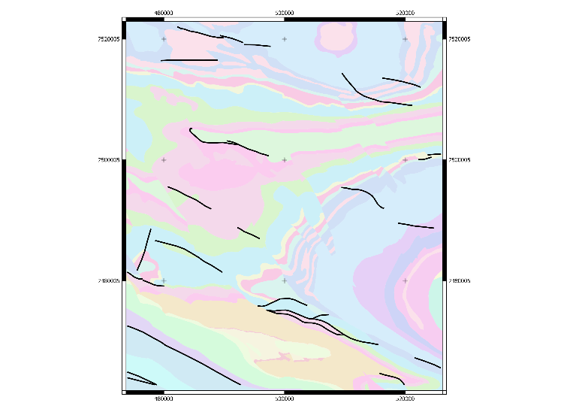
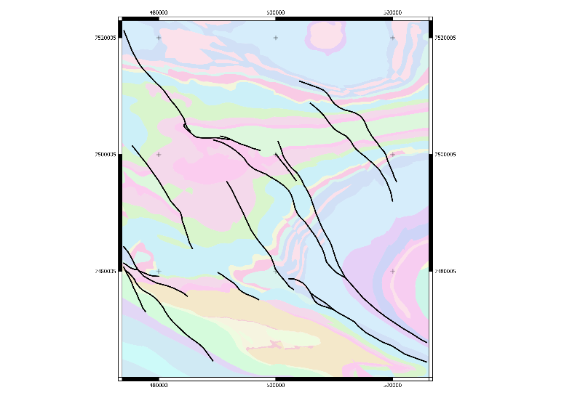
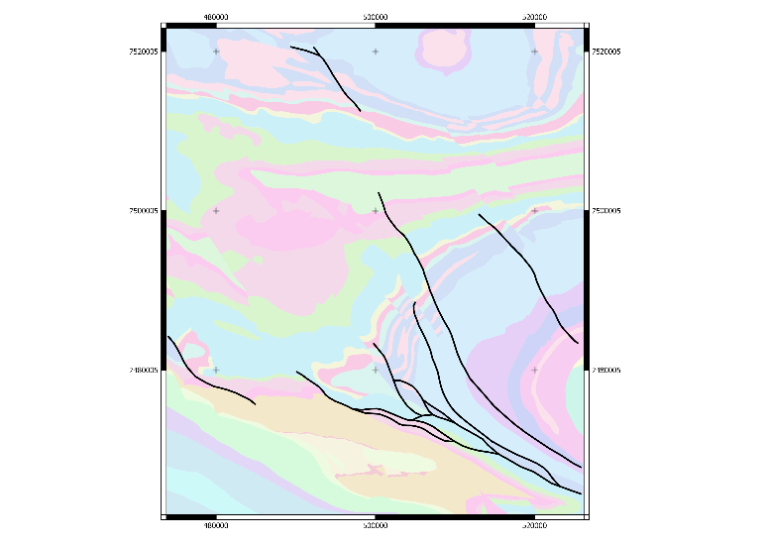
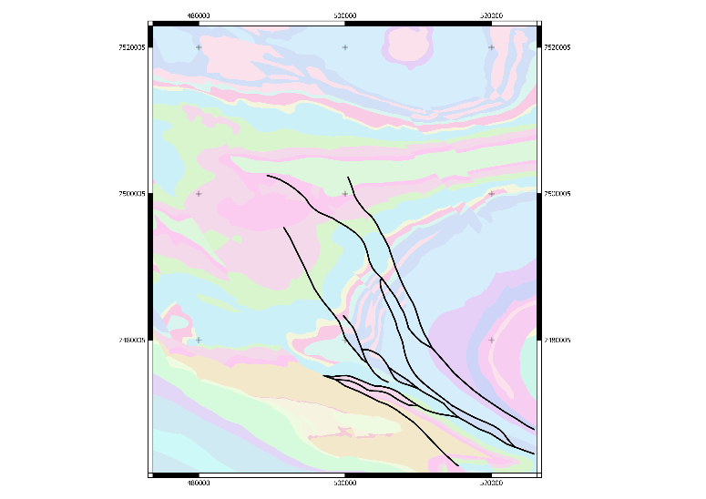
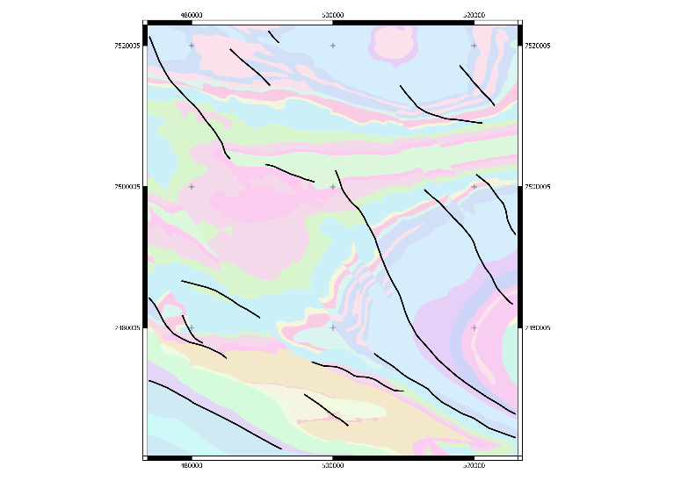
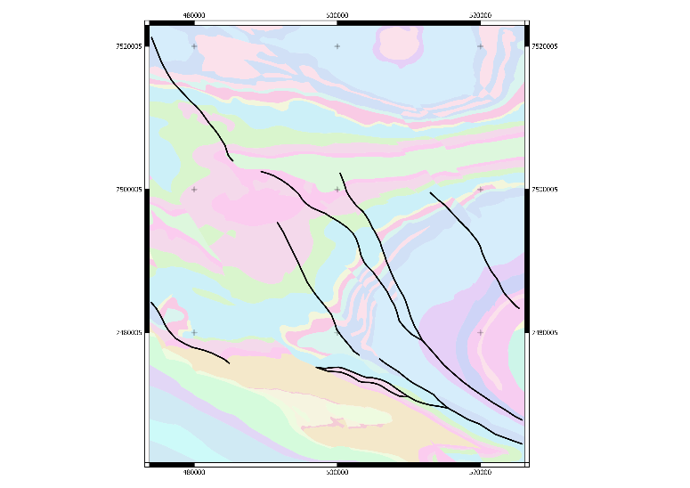

What data and conceptual constraints to use.
All
Cuts Brockman Fm
Longest
Highest Misorientation
Max stratigraphic offset
Closeness centrality
Betweenness centrality
Local Eldest
Most votes
Mark Jessell
Notes:
The University of Western Australia acknowledges that it is situated on Noongar land, that the Noongar people remain the spiritual and cultural custodians of their land and continue to practise their values, languages, beliefs and knowledge.
Welcome……

Slide 2
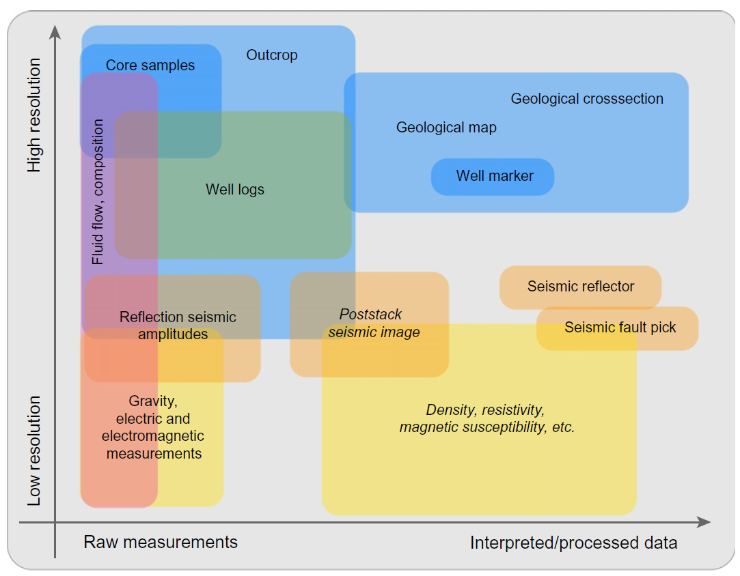
Typical Earth data used in geomodeling
Wellmann & Caumon 2018

Slide 3





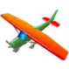
Depth of geo-observation
Observation | Platform | Property | Measurement
Topography |  | Elevation | EM Radiation
Geology |  | Lithology, structure | Geology 101
Spectral |  | Soils, Mineralogy, vegetation | EM Radiation
Radar (SAR) |  | Rugosity | EM Radiation
Radiometrics |  | U,K,Th | EM Radiation (gamma rays)
Radar (GPR) |  | Electrical Properties | EM Radiation
Electromagnetics |  | Conductivity, Capacitance | Electrical, magnetic fields
Magnetics |  | Susceptibility, Remanence | Magnetic field
Magnetotellurics |  | Impedance | Electrical, magnetic fields
Seismology |  | Elasticity | Vibration
Gravity |  | Density | Gravity
10⁻⁹
10⁻⁶
10⁻³
Max Depth of
Observation
log(m)
10⁻⁰
Satellite
Airborne
Ground
Borehole
10⁺³
10⁺⁶
Notes:
Ce second chapitre a montré qu’il existe beaucoup de techniques d’observations de la Terre.
Chacune de ces techniques mesure un paramètre différent.
Pour réaliser une carte géologique, il faut arriver à corréler et à comprendre l’intégralité de ces jeux de données et à identifier des structures communes reflétant des contacts lithologiques, failles, etc.
------------------------------------------------------------------------------
This second chapter has shown that there are many observations methods for the Earth.
Each of these techniques measure a different property.
To make a geological map, we must come to understand and correlate all of these data sets and to identify common structures reflecting lithologic contacts, faults, etc..

Slide 4
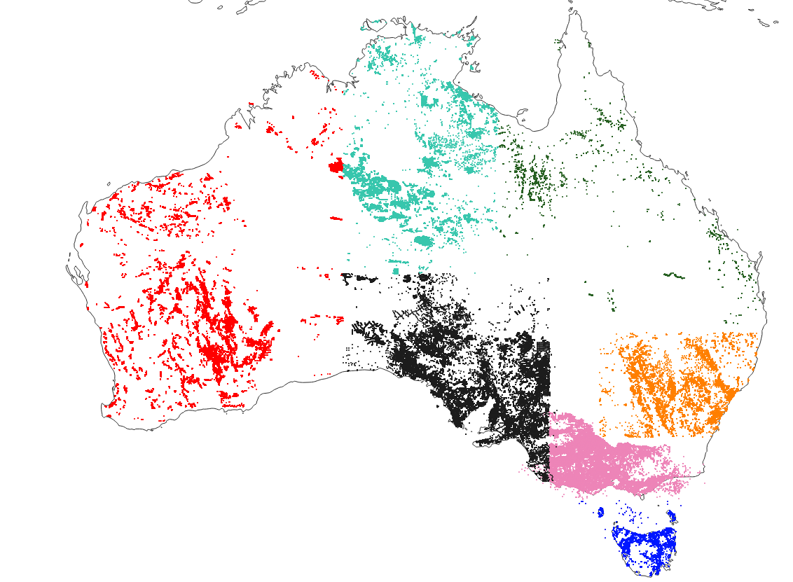
Australia’s Legacy Drillhole Data
4.3M collars in geosurvey databases
150M metres of logging information
>1 drillhole every 2 km²
2% > 200m
Average depth = 60m
210K
7,000 km
150 K
730 km
2,500 K
118,000 km
180K
11,500 km
940K
5,800 km
Challenges:
Need Stratigraphy for 3D modelling
Parallel efforts to harmonise geochemical information
Need lithology for interpretation
ML needs lithology for labelling
170K
9,500 km
240K
2,200 km

Slide 5
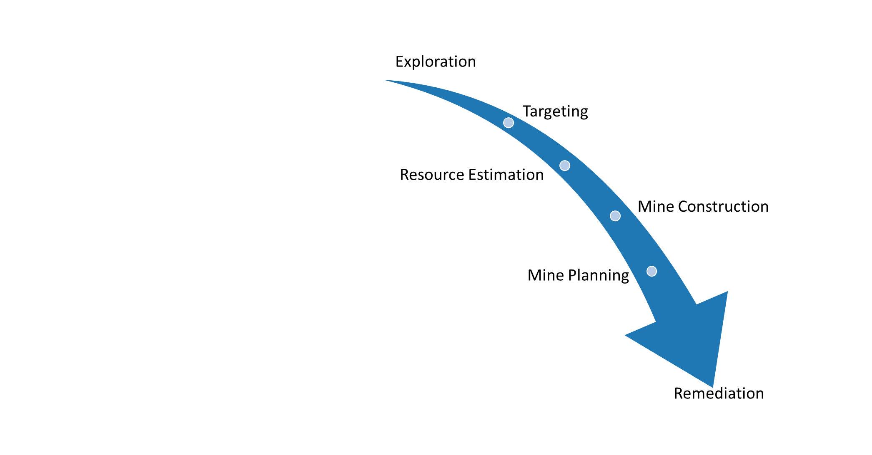
“Premature enumeration”
Which 3D models match my geological constraints?
Which models match my geophysical constraints?
Which interpolator should I use?
Which faults to model?
What is the dip of this fault?
Choice of data and features
Feature values
Modelling parameters
3D Geological Models
Geophysical Inversions
“The Uncertainty Chain”
Topology filters (e.g. faults that allow percolation in 3D)
Uncertainty analysis

Slide 6

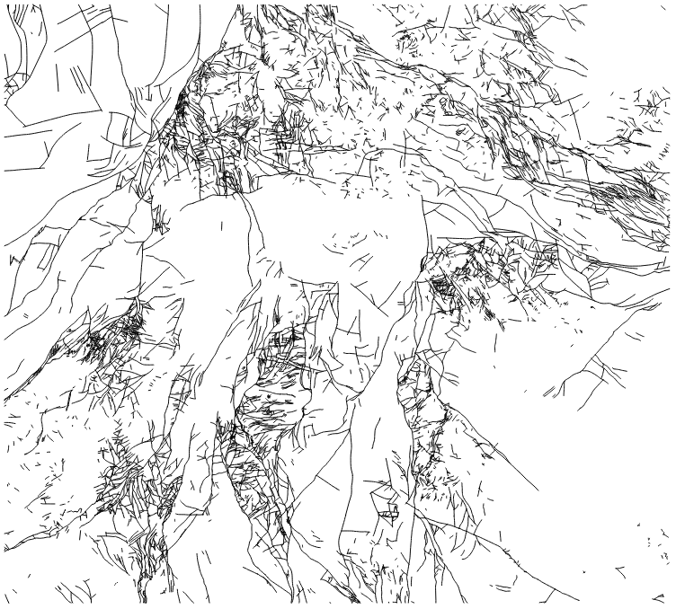
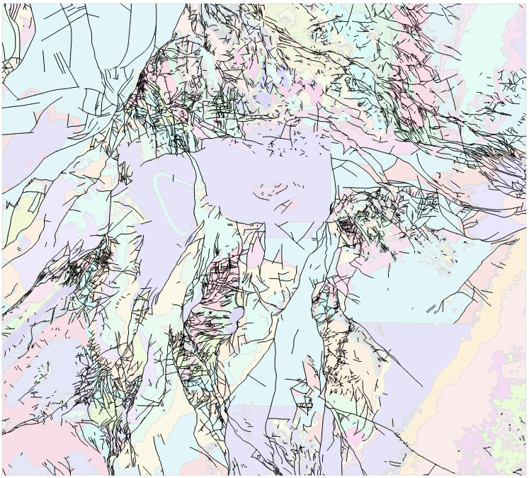
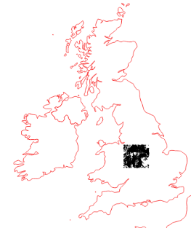
Which faults to model?

Slide 7

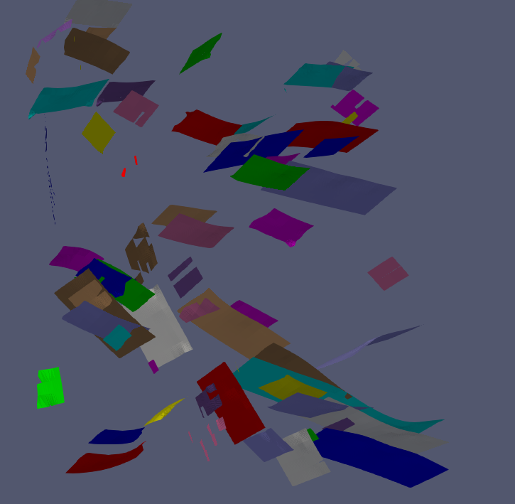
Which faults to model?
Question • Features to prioritise
Hydrogeology-Fluid flow potential
Long Length
Large Throw
Connected Topology
Local Wall Rock relationships
Mineralisation potential
Fluid Flow Potential
Spatial relationship to known mineralisation
Local Wall Rock relationships
High Fault Curvature
Large Misorientation
Relative Age

Slide 8
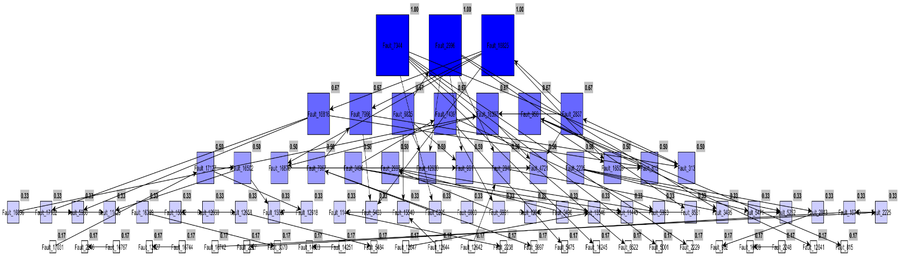
Fault/fault
relationships
Automated Topology
Size ∝ centrality
A
B
C
Fault A truncates fault B
B is most “central”
A is “eldest”

Slide 9
Which Faults to Model?
Intersects formation of interest (Brockman Formation) [30]
Length [14]
Faults at high angle to mean fault orientation [28]
Maximum stratigraphic offset across fault [18]
Topologically central in terms of distance to all other faults [14]
Topologically central in terms of position on shortest path between all faults [11]
Oldest fault in local network [16]
Most selected by criteria above [9]
Fault accepted Fault rejected
Notes:
Closeness centrality is defined as the reciprocal of the sum of the shortest path distances of a node to all other nodes in the graph. Therefore, a node with high closeness centrality has short distances to all other nodes of a graph.
Betweenness centrality is a measure for how often a node or edge lies on a shortest path between each pair of nodes in the graph.

Slide 10

All
Cuts Brockman Fm
Longest
Brockman Fm
Highest Misorientation
Max stratigraphic offset
Closeness centrality
Betweenness centrality
Local Eldest
Most votes
Which Faults to Model?
Notes:
Closeness centrality is defined as the reciprocal of the sum of the shortest path distances of a node to all other nodes in the graph. Therefore, a node with high closeness centrality has short distances to all other nodes of a graph.
Betweenness centrality is a measure for how often a node or edge lies on a shortest path between each pair of nodes in the graph.

Slide 11
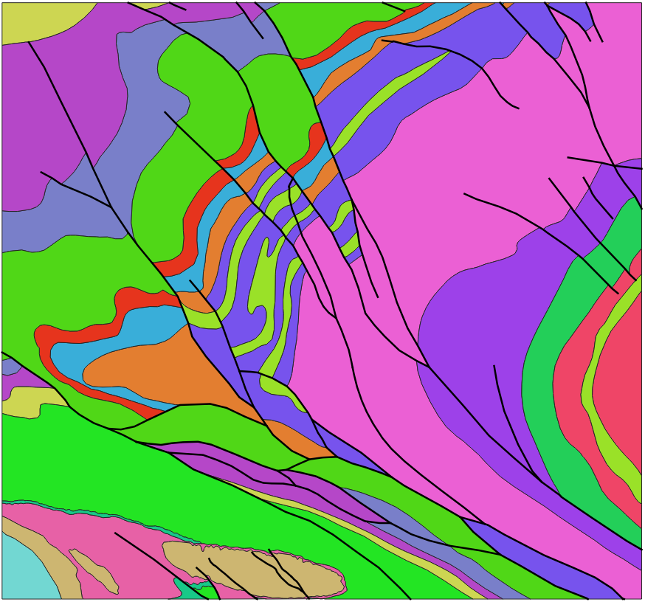

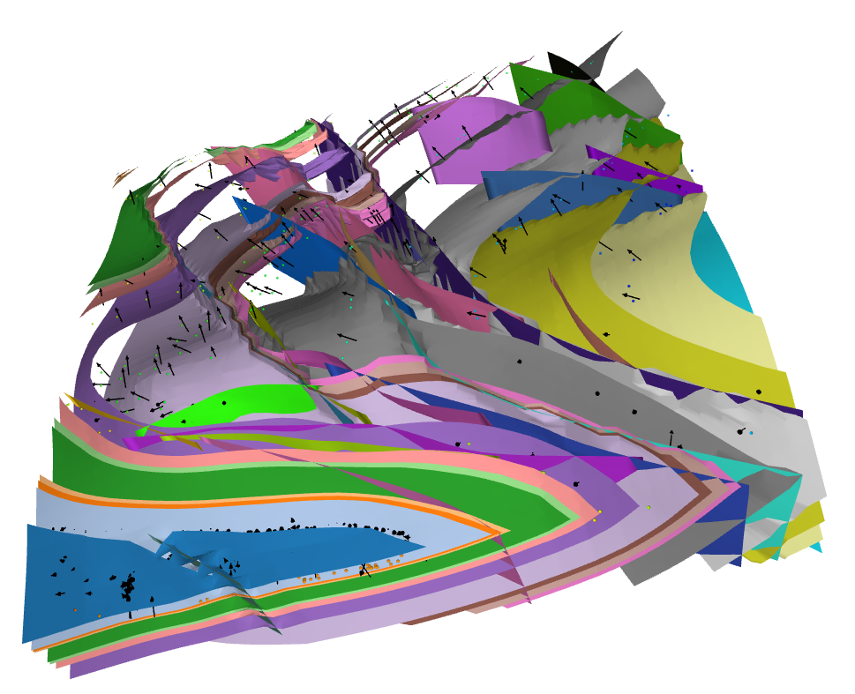

Fault intersection in 2D
Fault intersection in 3D
2D vs 3D connectivity of fault systems?

Slide 12
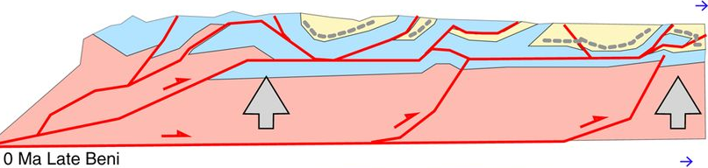
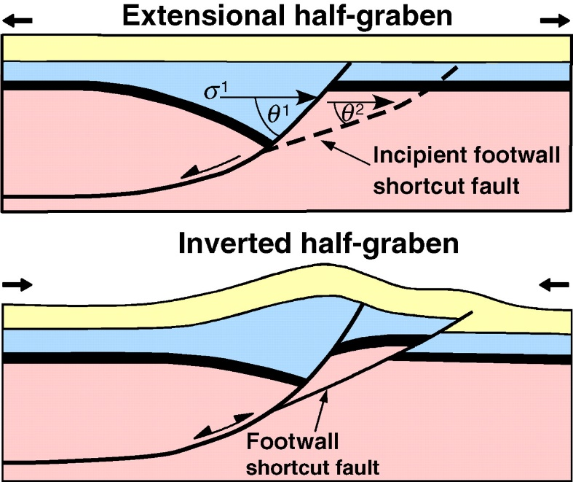
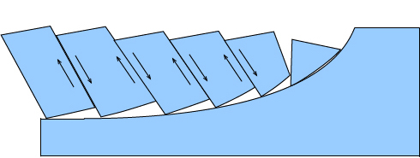
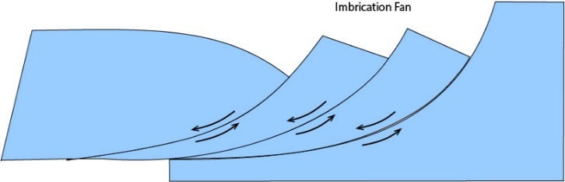
Conceptual Priors= Tectonic Context
Fold & Thrust
Extension & Inversion
Extensional
Transcurrent
Without limited geophysical constraints, the sub-surface geometry of faults is often ‘solved’ by applying a pre-conceived notion based on vertical, listric, flower or negative flower or fold & thrust geometries.

Slide 13
Conclusions
Which data to keep?
Accessible and Useable Data
Relevant data for your question
Data useful for constraining the model
Data relevant to scale of the model
Subset of data that retains most significant features
Be systematic: preferably automate the choices, or at least document them

